Slide 1
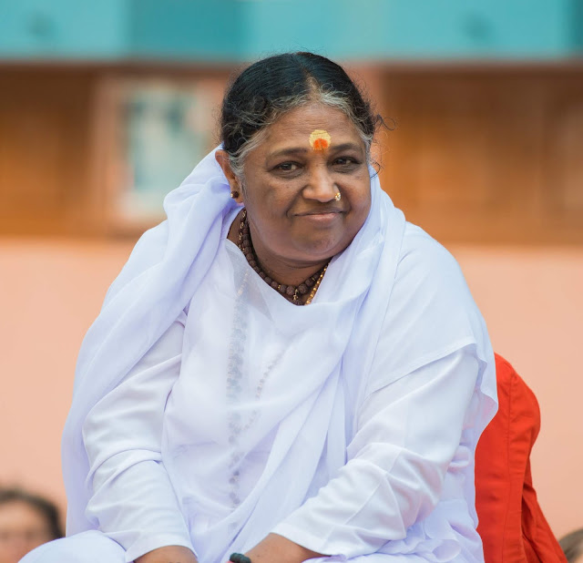
Enhancing Yoga Pose Recognition Through A Multi-Modal Hybrid Approach with Attention Mechanism and Late Fusion On YFA-30
Team Number : 16
Group Members :
1) Jayasurya Marasani - AM.EN.U4AIE20048
2) Abburi Sai Karthik - AM.EN.U4AIE20001
Mentor : Jayakumar T. V
Amrita School of Computing | Amrita Vishwa Vidyapeetham | Amritapuri

Slide 2
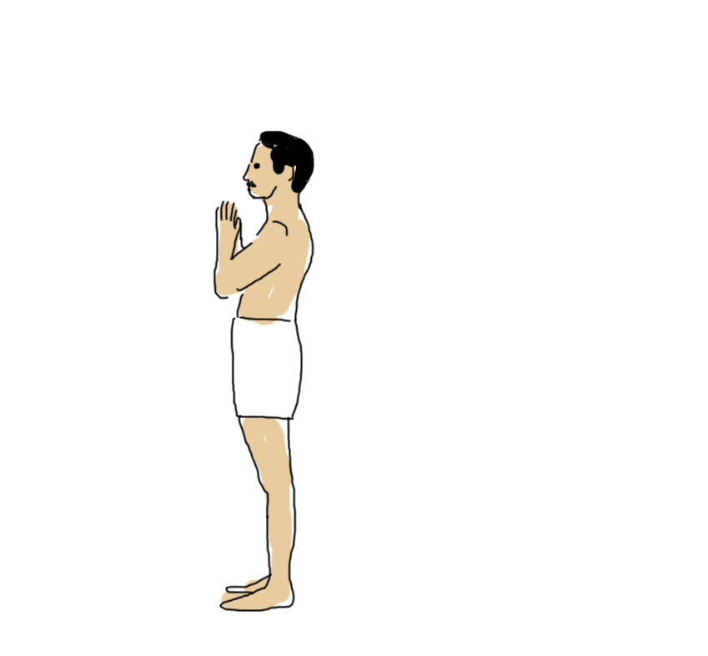
Introduction
What is yoga pose recognition?
The use of computer vision and machine learning to automatically identify and classify yoga poses from images or videos.
Why is it important?
Offers real-time feedback and guidance for yoga practice.
Improves accessibility for beginners and those without access to in-person instruction.
1

Slide 3
Motivation
Yoga promotes healthy living globally, with correct posture being crucial during practice.
Pose estimation systems enhance performance, preventing injuries and generating valuable practice-based performance data.
Deep learning and CNNs accurately classify diverse yoga poses using pose estimation.
2

Slide 4
Novelty
Hybrid Architecture Design: Introduced a novel approach combining landmark-based and landmark-free models to overcome drawbacks of existing solutions.
Custom Dataset Creation: Developed a dataset addressing image quality, pose variability and resolution concerns.
3

Slide 5
Background Study/Related Work
Title & Year | An Efficient Deep Convolutional Neural Network Model for Yoga Pose Recognition Using Single Images, June 27 2023.
Problem | YPose, a novel model introduced in this study, enhances the accuracy of recognizing yoga poses from single images, addressing a challenging task.
Contributions | Development of the YPose model using EfficientNet and dense refinement blocks for yoga pose recognition from RGB images. Model achieves high accuracy on the Yoga-82 dataset Integrating segmentation and detection refines images, aiding feature extraction for lightweight models on resource-limited devices.
Limitations | Model's generalization across diverse datasets and real-world scenarios beyond Yoga-82 may pose a limitation, though not explicitly stated.
Open Problems / Future Work | Explore the model's application and performance on other datasets and in real-world settings. Develop methods to address challenges in pose recognition, such as occlusions and variations in body shapes. Extend the research to cover dynamic pose recognition, capturing sequences of yoga poses over time..
4

Slide 6
Background Study/Related Work
Title & Year | Fine-Grained Sports Yoga and Dance Postures Recognition: A Benchmark Analysis, Feb 2023.
Problem | Current recognition systems struggle with detailed body movements in sports, yoga, and dance. To address this, researchers are exploring SYDNet, a specialized deep learning model.
Contributions | Development of SYD-Net, a deep learning model with a novel patch-based attention mechanism for recognizing fine-grained sports, yoga, and dance postures. Creation and introduction of two new image datasets: Sports-102 and Dance-12, to address the lack of public datasets in these domains. Extensive experimentation using five backbone CNN architectures, demonstrating the effectiveness of the proposed model and approach.
Limitations | potential limitations of the SYD-Net model may include constraints related to dataset diversity, model generalizability, and computational efficiency
Open Problems / Future Work | Further refinement of the patch-based attention mechanism to enhance model performance and efficiency. Expansion of the dataset to include more diverse and comprehensive examples of sports, yoga, and dance postures. Exploration of the model's applicability to other fine-grained recognition tasks in different domains.
5

Slide 7
Background Study/Related Work
Title & Year | A View Independent Classification Framework for Yoga Postures, Aug 2022.
Problem | To simplify the recognition of yoga poses from various angles using a two-step method.
Contributions | Creating a view-independent yoga posture classifier with a two-stage architecture: pose estimation followed by classification. Creation of an extensive yoga pose dataset from multiple camera angles. Introduction of a three-stage evaluation strategy to assess model generalization across unseen frames, subjects, and camera angles.
Limitations | Certain yoga poses may be challenging to identify from specific camera angles. Pose estimation accuracy is crucial, as errors at this stage can greatly impact subsequent classification performance.
Open Problems / Future Work | Enhancing the pose estimation module to improve accuracy and generalizability. Expanding the dataset to include more yoga poses and possibly incorporating additional modalities like video or depth data for better recognition. Further refining the evaluation strategy to address potential biases and ensure a comprehensive assessment of model performance.
6

Slide 8
Background Study/Related Work
Title & Year | Pose Embeddings: A Deep Architecture for Learning to Match Human Poses, Jul 2015.
Problem | To Develop a method to compare human poses directly, bypassing explicit pose estimation. Learn an embedding to cluster images of people in similar poses.
Contributions | Pose matching formulated as direct learning via deep architecture. Algorithm development: Triplet-based distance for pose representation, enabling effective pose matching and retrieval from video data.
Limitations | This Method utilizes deep architecture, requires substantial computational resources for both training and inference. Direct learning of pose similarity without explicit estimation may Introduce challenges with occluded body parts or uncommon poses.
Open Problems/ Future Work | Explore extending the pose matching framework to diverse domains beyond pose similarity, broadening its applicability in various applications. Tackle challenges of occluded body parts and unusual poses by integrating extra training data or features.
7

Slide 9
Persisting Challenges
Challenges Identified:
Dataset Imbalance and Quality
Original datasets exhibited uneven class sizes with some classes having insufficient images.
Presence of images like vector humans, diagrams of humans and mislabeled images negatively impacted model training.
Fine-Grained Pose Variations
Datasets contained subtle differences within poses, posing a challenge for classification accuracy.
Overfitting in Landmark Free and augmented based Models
High training accuracy but low validation accuracy pointed towards overfitting, even with data augmentation.
8

Slide 10
Persisting Challenges
Challenges Addressed in the Project
All the challenges mentioned above are addressed in the project through:
Custom Dataset Creation
Developed a carefully curated dataset addressing:
Class balance with a minimum of 250 images per yoga pose.
Image quality with focus on real humans in poses.
Pose variability to enhance model robustness.
Hybrid Approach with Self Attention and Late Fusion
Leveraging strengths of both landmark-augmented and landmark-free models to tackle complex poses and mitigate potential overfitting.
Self Attention and Late fusion combines insights from both models, potentially boosting accuracy.
9

Slide 11
Dataset
Yoga For All Dataset (YFA-30)
30 Classes
7932 Images
Minimum of 250 images in each class
Made subsets of 3 datasets from one YFA-30 to analyze how the model is performing on different sizes of data
YFA-10
YFA-20
YFA-30
10

Slide 12
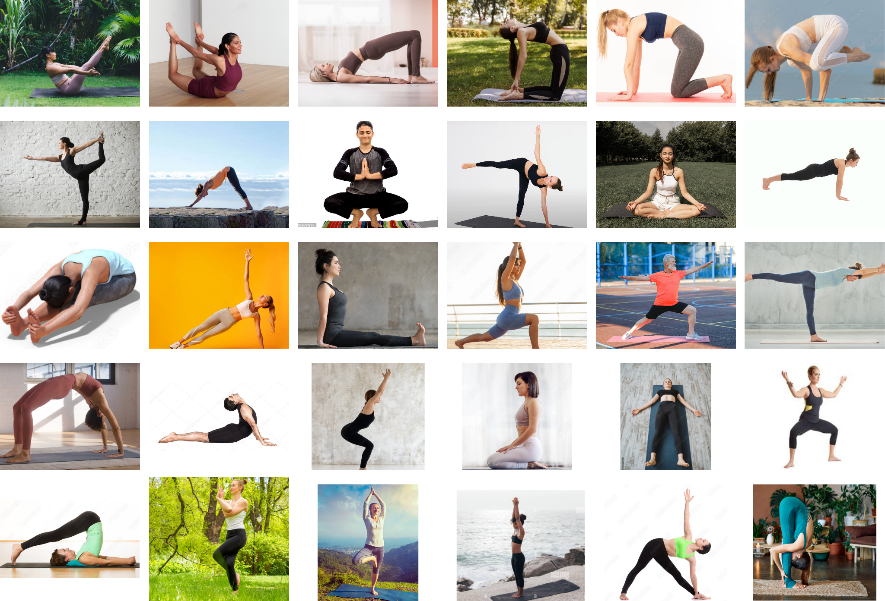
Dataset (contd)
Fig. 1: YFA-30 Dataset of 30 yoga poses
11

Slide 13
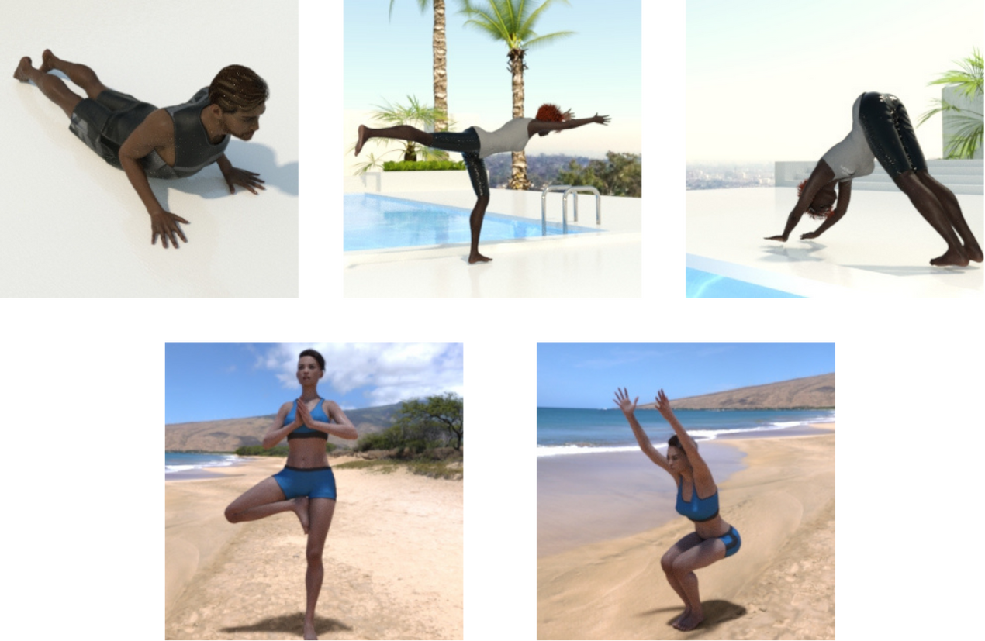
Dataset (contd)
Google CG Dataset
5 Classes
1495 images
Train Set contains 1000 images
Test Set contains 495 images
Fig. 2: Google CG Dataset of 5 poses
12

Slide 14
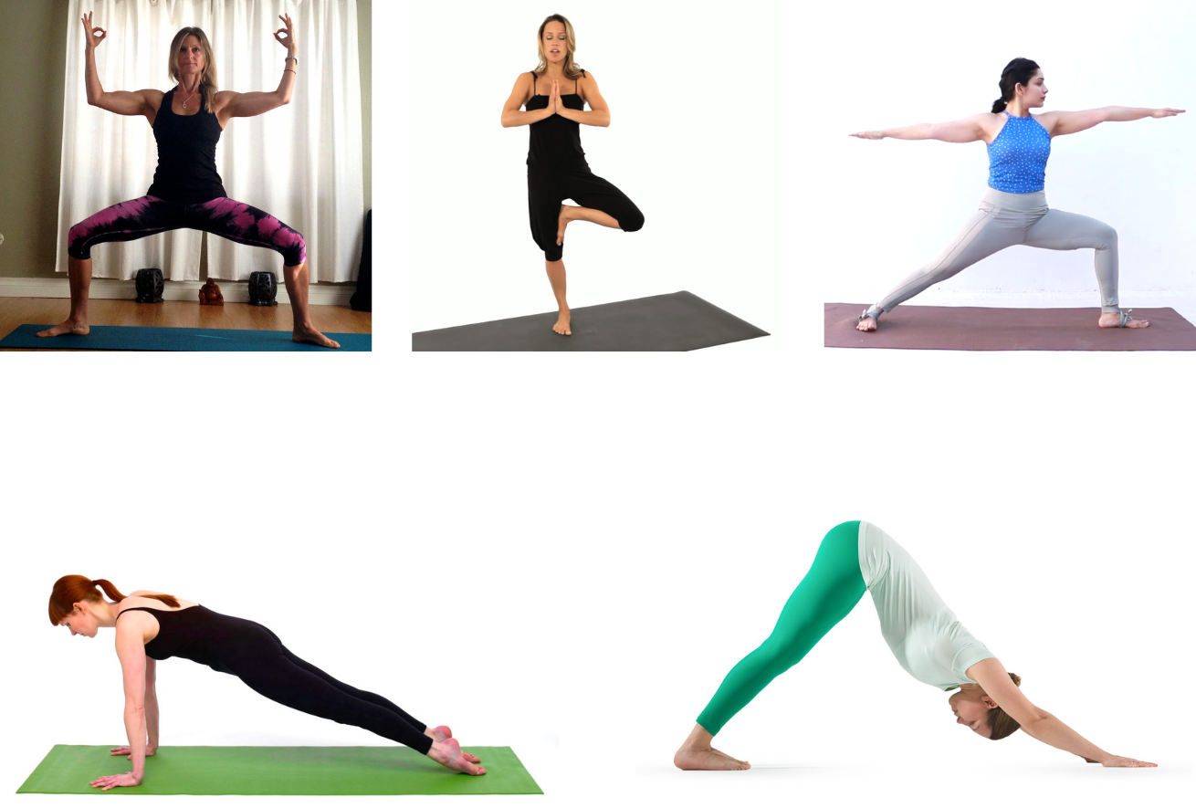
Dataset (contd)
Kaggle Dataset
5 Classes
1551 images
Train Set contains 1081 images
Test Set contains 470 images
Fig. 3: Kaggle Dataset of 5 yoga poses
13

Slide 15
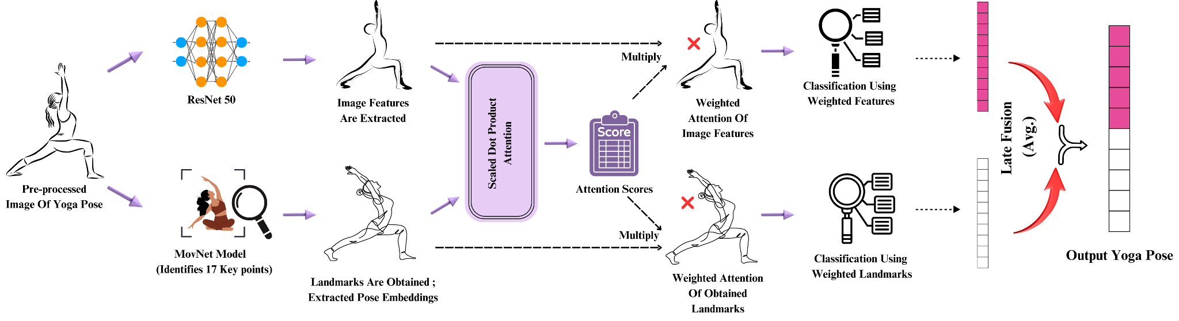
High Level Design
Fig. 4: Architecture of Hybrid Model
14

Slide 16
Methodology
Data Preprocessing
Resizing the image to 224*224
Images are explicitly pre-processed to match the input for ResNet50
Converted from RGB to BGR
Normalized the pixel values in the range from 0 to 1
15

Slide 17
Methodology (contd)
Feature Extraction
Pre-processed images are fed into MoveNet and ResNet50 models.
MoveNet
Identifies 17 key points in each image.
Landmarks are converted into pose embeddings (compact representations of keypoint configuration).
ResNet50
Extracts image features using the weights learned from ImageNet dataset
16

Slide 18
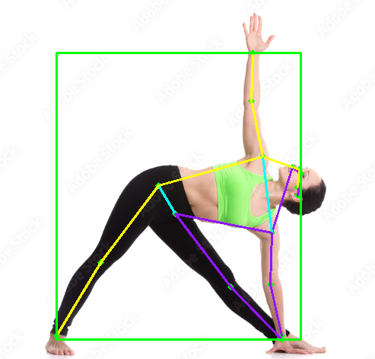
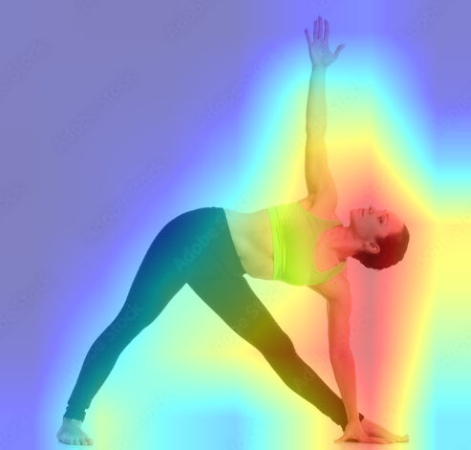
Methodology (contd)
Feature Extraction
Fig. 5 : Landmarks extracted using MoveNet
Fig.6 : Representation of Image Features extracted by ResNet50
17

Slide 19
Methodology (contd)
Feature Transformation and Dimensionality Reduction
Extracted pose embeddings and image features are fed into a deep learning Network.
Uses dense layers to further reduce the size of the features separately creating a more compact representation.
Dropout layers are included for regularization to prevent overfitting.
Batch normalization layers are used to stabilize the training process and improve convergence.
18

Slide 20
Methodology (contd)
Classification
Scaled Dot Product Attention Mechanism
combines pose embeddings and image features
Focuses on relevant parts using attention weights
Attention scores are calculated between pose embeddings and image features using dot product
Softmax function normalizes scores
Pose Embeddings and Image Features are multiplied by their scores to get landmark and image weights
19

Slide 21
Methodology (contd)
Classification
Late Fusion
Combines weighted feature representations of Pose Embeddings and Image Features
Uses Average Layer to combine the feature representations
Creates a unified representation capturing information from both modalities (landmarks and image).
Unified representation is used for classification into one of distinct yoga poses
20

Slide 22
Methodology(contd.)
Model Exploration
Evaluated landmark-free models
Model | Parameters | Size | Input Shape
ResNet50 | 49.29M | 188.06MB | 224*224*3
Vgg16 | 21.15M | 80.71MB | 224*224*3
EfficientNetB0 | 20.12M | 76.77MB | 224*224*3
InceptionV3 | 34.92M | 133.25MB | 224*224*3
MobileNetV2 | 18.33M | 69.64MB | 224*224*3
Xception | 73.31M | 279.66MB | 299*299*3
Table. 1: Landmark-free Models for All Datasets
21

Slide 23
Methodology(contd.)
Model Exploration
Evaluated landmark Augmented models
Model | Parameters | Size | Input Shape
MoveNet | 27.35K | 106.87KB | 51
MediaPipe | 70.94k | 275.37KB | 99
Yolo-v8x-Pose | 52.06k | 203.37KB | 34
Table. 2: Landmark-Augmented Models for All Datasets
22

Slide 24
Methodology(contd.)
Hybrid Architecture Design
Developed a hybrid architecture using self-attention mechanism and late fusion technique with an average layer to combine classification results.
parameters - 49.3 million
Size of parameters - 188.16 MB
Input Shape - {51,[224*224*3]}
23

Slide 25
Methodology(contd.)
Evaluation of Hybrid Yoga Pose Recognition Model
Comparing the proposed hybrid model with landmark-based and landmark-free approaches.
Landmark-Based: High joint accuracy, vulnerable to occlusions.
Landmark-Free: Good overall pose recognition, struggles with specific joints.
Hybrid: Combines precision and robustness for superior accuracy and efficiency.
24

Slide 26
Results and Analysis
Metrics | YFA-30 | YFA-20 | YFA-10 | Google | Kaggle
Train Accuracy | 98.56 | 99.57 | 99.58 | 100 | 99.80
Val Accuracy | 94.08 | 95.86 | 98.16 | 94.71 | 98.03
Test Accuracy | 95.80 | 96.38 | 99.18 | 97.80 | 98.68
Train Loss | 0.0438 | 0.0217 | 0.0164 | 0.0095 | 0.0356
Val Loss | 0.2255 | 0.1245 | 0.0600 | 0.1985 | 0.0685
Test Loss | 0.1615 | 0.1414 | 0.0468 | 0.1918 | 0.0828
Precision | 96 | 96 | 99 | 98 | 99
Recall | 96 | 96 | 99 | 98 | 99
F1-score | 96 | 96 | 99 | 98 | 99
Table. 3: Classification Report of Hybrid Model on all datasets
25

Slide 27
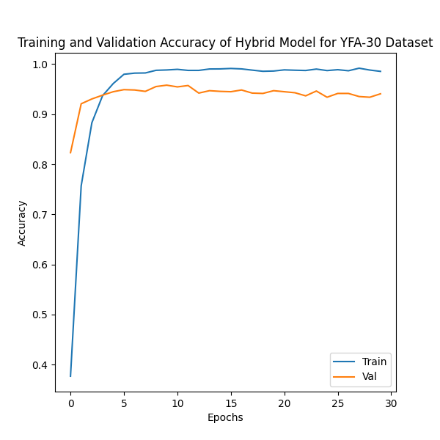
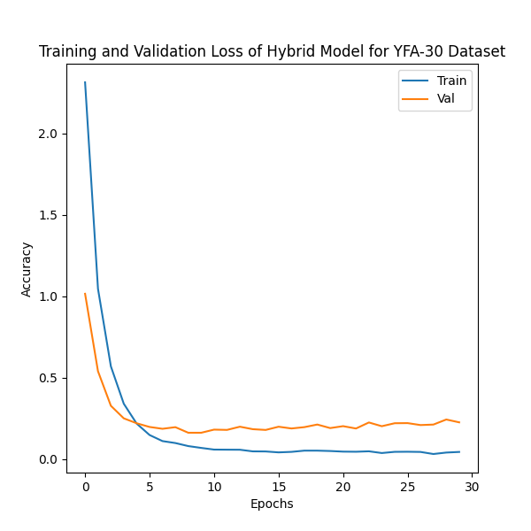
Results and Analysis
Fig.7 : Training and Accuracy plots of YFA-30 Dataset using Hybrid Model
26

Slide 28
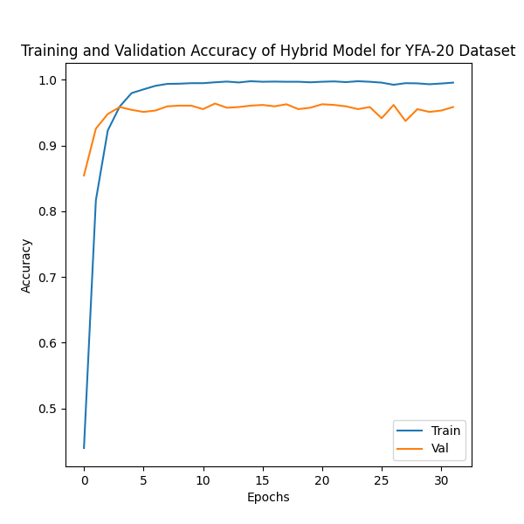
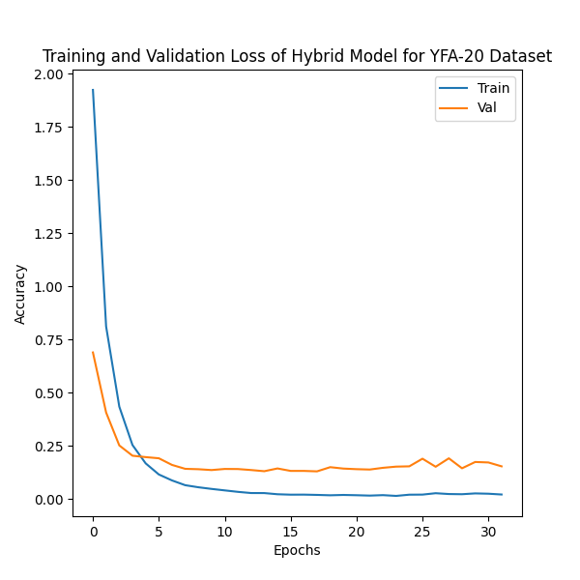
Results and Analysis
Fig.8 : Training and Accuracy plots of YFA-20 Dataset using Hybrid Model
27

Slide 29
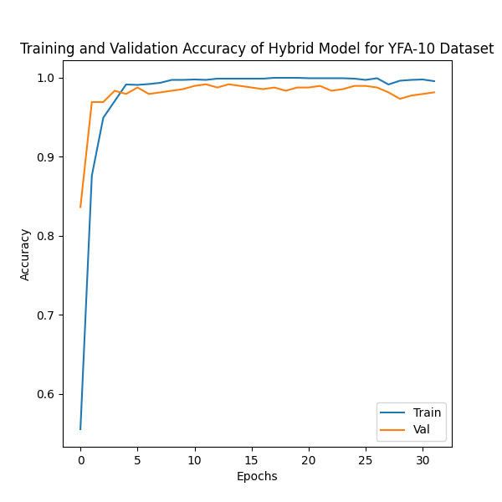
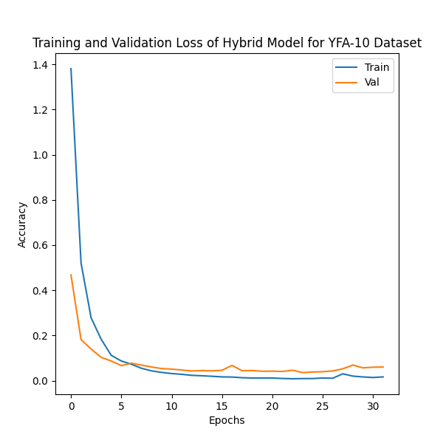
Results and Analysis
Fig.9 : Training and Accuracy plots of YFA-10 Dataset using Hybrid Model
28

Slide 30
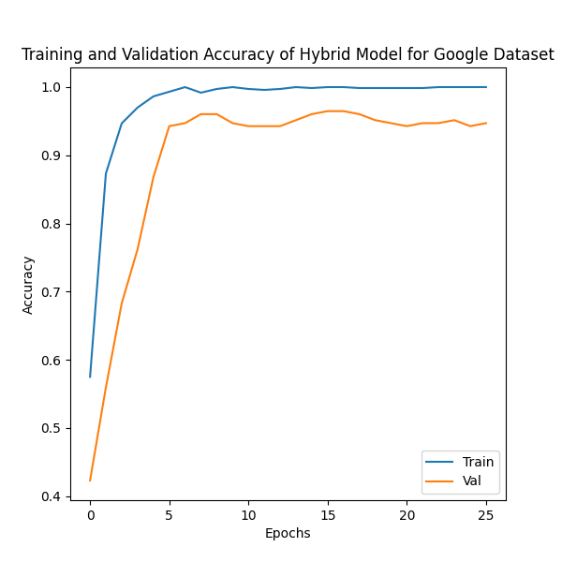
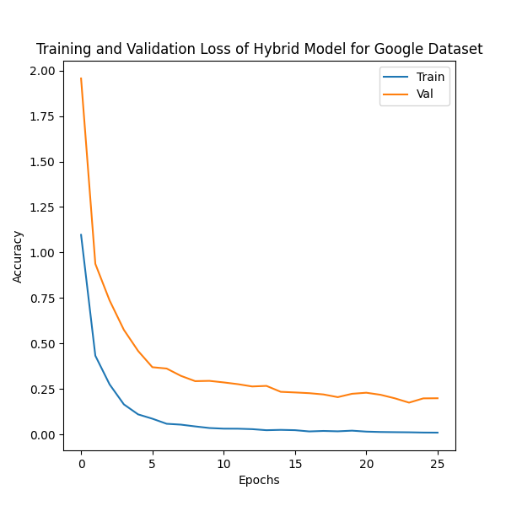
Results and Analysis
Fig.10 : Training and Accuracy plots of Google Dataset using Hybrid Model
29

Slide 31
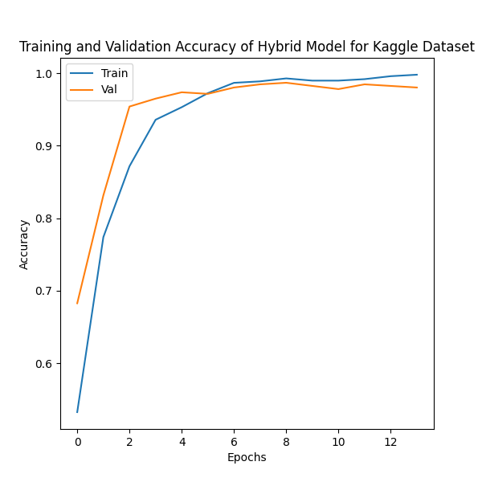
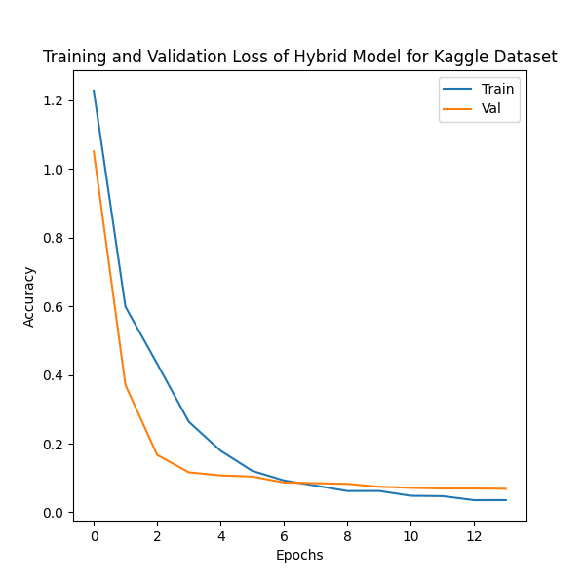
Results and Analysis
Fig.11 : Training and Accuracy plots of Kaggle Dataset using Hybrid Model
30

Slide 32
Discussion
Strengths
Superior Accuracy and Generalizability
Attention Mechanism focuses on critical features for precise pose classification
Late Fusion effectively merges information from multiple sources, enhancing robustness and accuracy
Limitations
Computational Complexity
Dataset Size
Static Poses
31

Slide 33
Future Scope
Video-based Pose Recognition
Classification of poses within dynamic yoga sequences.
Analysis of pose transitions for a more complete understanding of yoga practice.
Real-time Yoga Trainer Application
Improve Computational Efficiency
Expanding Datasets
Adding more images to YFA-30 dataset
Adding more poses to YFA dataset
Creating a dataset with videos
32

Slide 34
Conclusion
In this project, a novel hybrid model for yoga pose recognition that leverages a multi-modal approach with attention mechanisms and late fusion.
Developed the YFA-30 dataset
Hybrid model integrates MoveNet's precise landmark detection with ResNet50's holistic image feature extraction.
Hybrid Model surpassed the performance of individual landmark-based and landmark-free approaches.
Multi-Modal strategy effectively captured both the intricate details of yoga poses and the overall visual context (through image features).
The incorporation of a scaled dot-product attention mechanism further optimizes the model by focusing on the most relevant features for accurate classification.
33

Slide 35
Journal Targeted
Image and Vision Computing (IMAVIS)
Impact Factor -4.7
Cite Score - 7.3
Q1 Elsevier Journal
Submitted to the journal
34

Slide 36
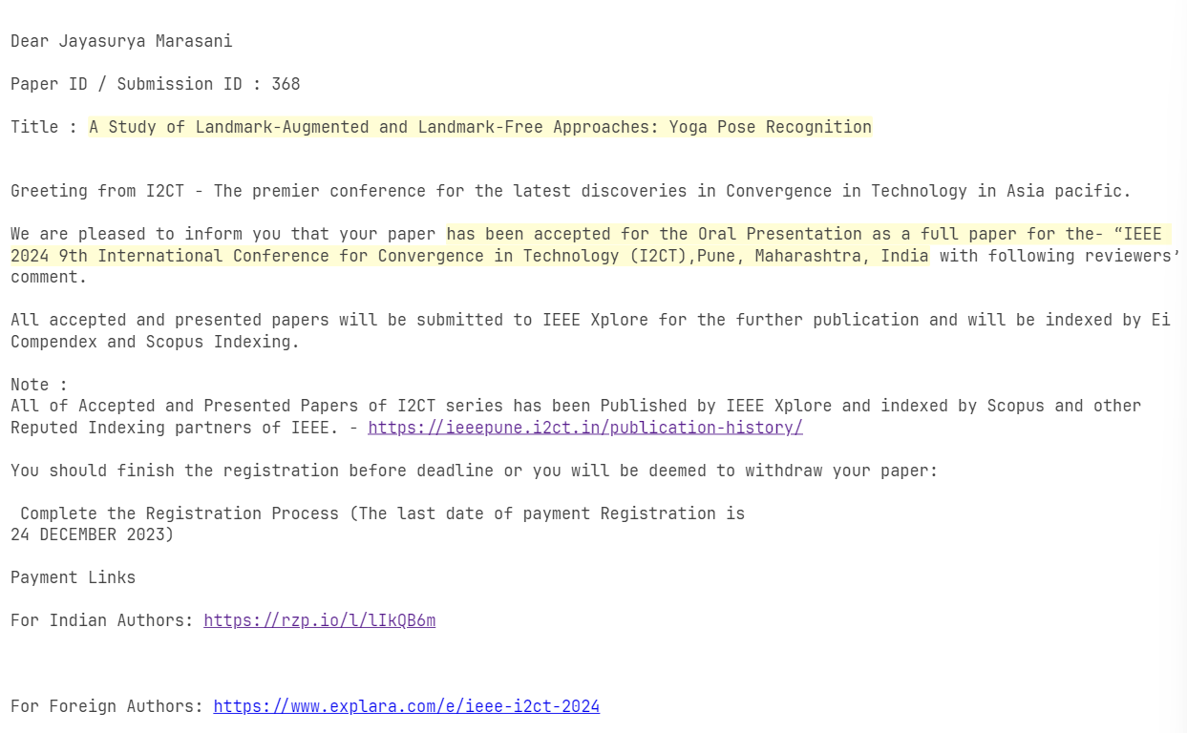
Conferences Targeted
Presented the paper
IEEE 9th I2CT India
05th-07th April 2024
Pune, India
Ei Compendex and Scopus Indexing
Fig. 12: Acceptance Mail from I2CT
35

Slide 37
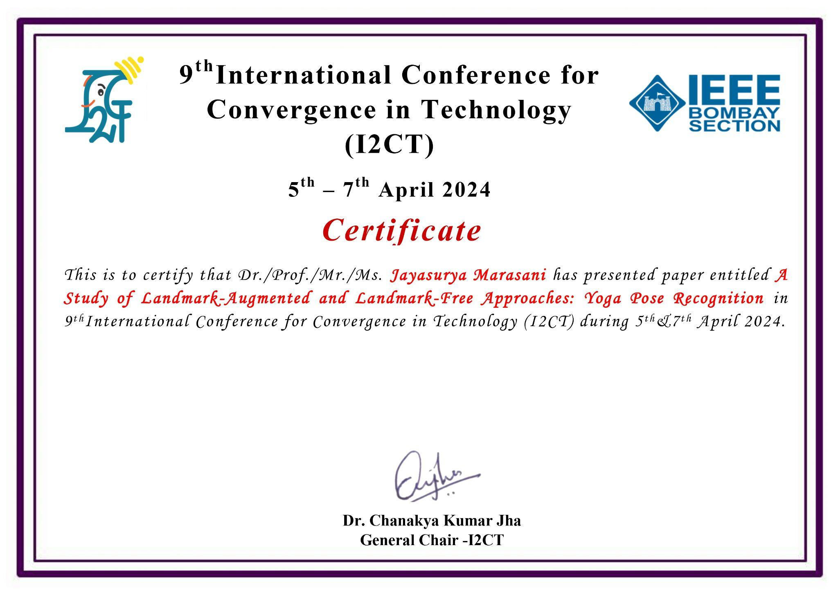

Conferences Targeted
Fig.13 :Certificates of Participation
36

Slide 38
References
S. K. Yadav, A. Shukla, K. Tiwari, H. M. Pandey, and S. A. Akbar, "An Efficient Deep Convolutional Neural Network Model For Yoga Pose Recognition Using Single Images," arXiv:2306.15768, 2023.
M. Chasmai, N. Das, A. Bhardwaj, and R. Garg, "A View Independent Classification Framework for Yoga Postures," SN Computer Science, vol. 3, no. 6, p. 476, 2022.
A. Bera, M. Nasipuri, O. Krejcar, and D. Bhattacharjee, "Fine-Grained Sports, Yoga, and Dance Postures Recognition: A Benchmark Analysis," IEEE Transactions on Instrumentation and Measurement, 2023.
G. Mori et al., "Pose embeddings: A deep architecture for learning to match human poses," arXiv preprint arXiv:1507.00302, 2015.
D. Parashar, O. Mishra, K. Sharma, and A. Kukker, "Improved yoga pose detection using MediaPipe and MoveNet in a deep learning model," Revue d'Intelligence Artificielle, vol. 37, no. 5, pp. 1197-1202, 2023. DOI: 10.18280/ria.370511
M. Desai and H. Mewada, "A novel approach for yoga pose estimation based on in-depth analysis of human body joint detection accuracy," PeerJ Computer Science, vol. 9, pp. e1152, 2023. DOI: 10.7717/peerj-cs.1152
37

Slide 39
Thank You

